Slide 1
Künstliche Intelligenz in der Gesundheitsversorgung
Dipl.-Ing. Dr.techn. Alexander Jung
Associate Professor at Dept. of CS (Aalto)

Slide 2
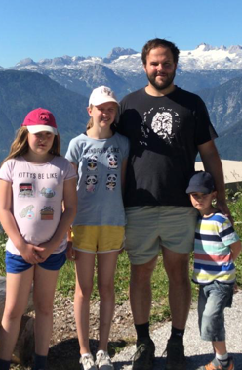






Zur Person.
2012: Dr.techn., Elektrotechnik, TU Wien
2012 – 2015: Post-Doc TUW, ETH Zurich
2015-2022 : Assistant Prof. ML, Aalto
2019- : Trainer, Aalto EE
2023 - : Associate Professor (Tenured), Aalto
Berater für KI Unternehmen

Slide 3
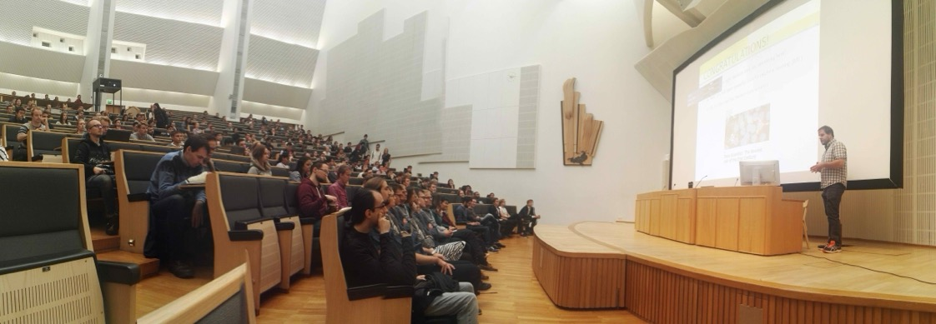
Arbeitsalltag als Professor.

Slide 4

Nach 8 Jahren Lehre.
AJ, „Maschinelles Lernen:
Die Grundlagen“, Springer, 2024

Slide 5
Lernziele für diesen Vortrag.
Bewusstsein für Verbreitung von KI im Alltag
KI Funktionsprinzip
KI Anwendungen im Gesundheitswesen

Slide 6
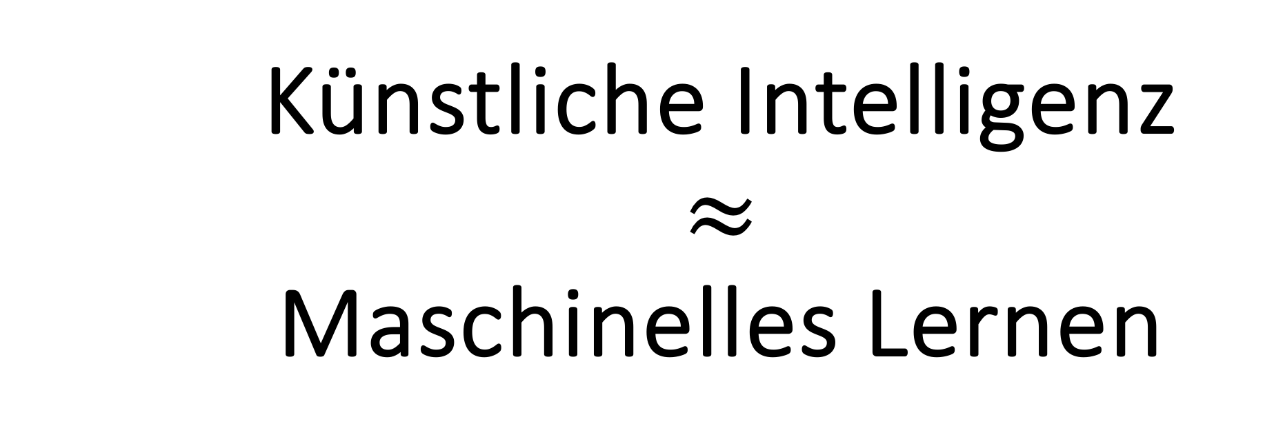
Künstliche Intelligenz $$≈$$ Maschinelles Lernen

Slide 7

Maschinelles Lernen (ML)
fixer Bestandteil unseres Alltags!
Notes:
Let me start my talk with the relatively trivial Observation that machine learning is everywhere and has become commonplace in our daily lives. Most of us heavily use ML-powered apps on our smartphones, which has almost become an additional body part of its user. However, reflecting on how much ML has already affected your life might be a revealing exercise.

Slide 8

ML wählt unseren Job!
Notes:
Maybe some of you have found their current job based on a ML algorithm that decided to show a certain job ad to you. Some 8 years ago, I was presented a job ad for a tenure track position at a university called Aalto university. At that time I have not heard about this university, which was founded only few years before. However, some recommendation algorithm decided to show me the job ad on a social network for researchers. Recommendation systems have been one of the most successful application domains of machine learning. I want to emphasize that I did not have any personal contacts that pointed this tenure track position to me. Thus, I applied for this job only because a machine learning based recommender system showed me a job ad.

Slide 9

ML wählt unsere Partner aus!
Notes:
Beside your professional life, also your private life might have been already heavily influenced or even decided by ML. Indeed, maybe some of you have found your current partner via a dating site. These sites also use ML powered recommendation systems for choosing user profiles that are suggested to you. One of these suggestions has become my wife and we are happily married for several years. Thus, to some extend, my current job and wife has been decided for me by ML.

Slide 10
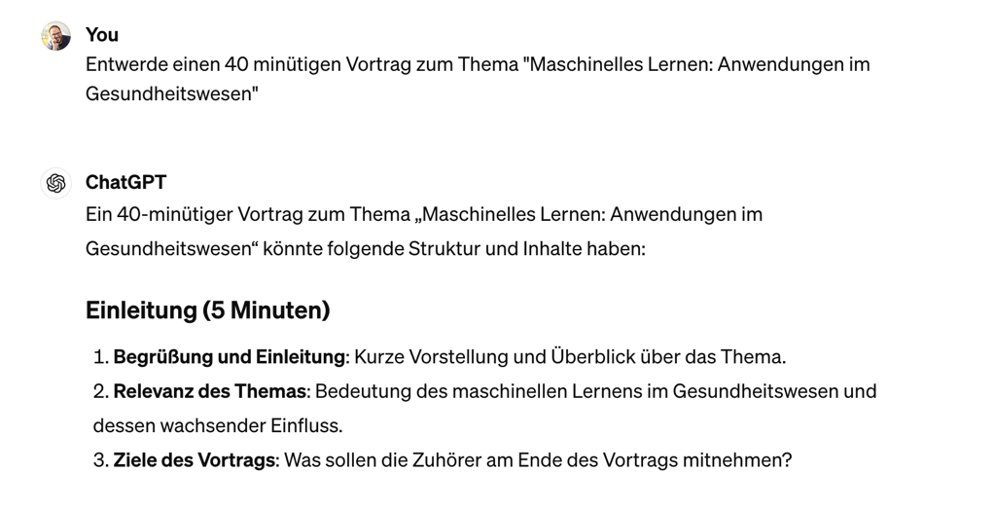
ML entwickelt Vorträge !

Slide 11
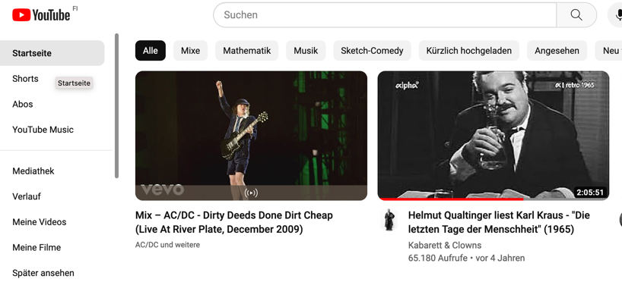
ML wählt Hintergrund-Berieselung!
Notes:
Beside these far-reaching decisions, you might also regularly follow the suggestions for videos or music in online streaming platforms. Maybe some of you also had these moments of surprise when a recommendation algorithm picked a song that you loved from the first tune but did not know before. Such moments can also be scary as they suggest the potential of ML systems to profile us humans.

Slide 12
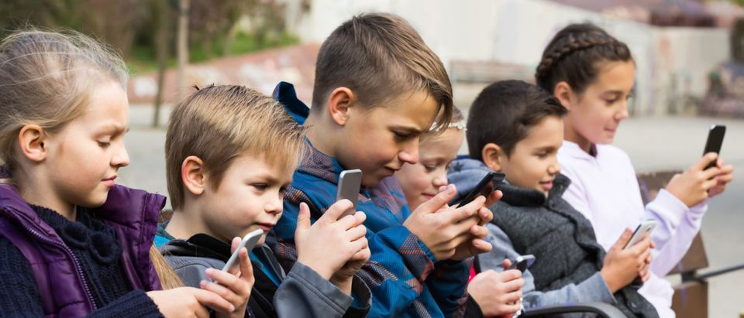
ML macht Smartphone zu Herrscher!
https://dailycaller.com/2018/12/10/staring-smartphone-kids-brain/

Slide 13
ML kann krank machen!
“Further, some researchers believe that social media exposure can overstimulate the reward center in the brain and, when the stimulation becomes excessive, can trigger pathways comparable to addiction…”
Surgeon General. 2023. Social Media and Youth Mental Health: The U.S. Surgeon General’s Advisory. https://www.hhs.gov/sites/default/files/sg-youth-mental-health-social-media-advisory.pdf

Slide 14

Zulassungen von KI Medizintechnik
“Through the end of July 2023, 79% of devices authorized in 2023 are in Radiology (85), 9% in Cardiovascular (10), 5% in Neurology (5), 4% in Gastroenterology/Urology (4), 2% in Anesthesiology (2), and 1% each in Ear, Nose and Throat (1), and Ophthalmic (1).”
https://www.fda.gov/medical-devices/software-medical-device-samd/artificial-intelligence-and-machine-learning-aiml-enabled-medical-devices

Slide 15
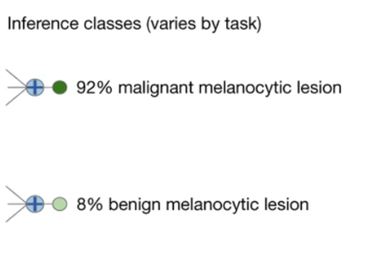
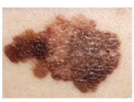

Meiste KI Zulassungen in Radiologie.
KI
Esteva, A. et al. Dermatologist-level classification of skin cancer with deep neural networks. Nature 542, 115–118 (2017).

Slide 16
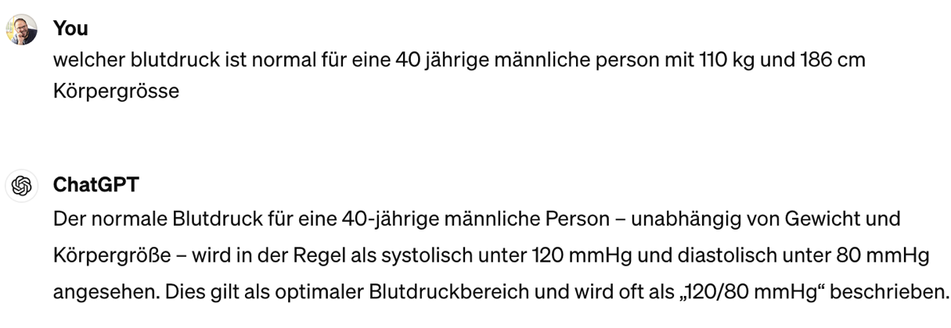
KI Erfolgslauf von Bildern zu Text

Slide 17
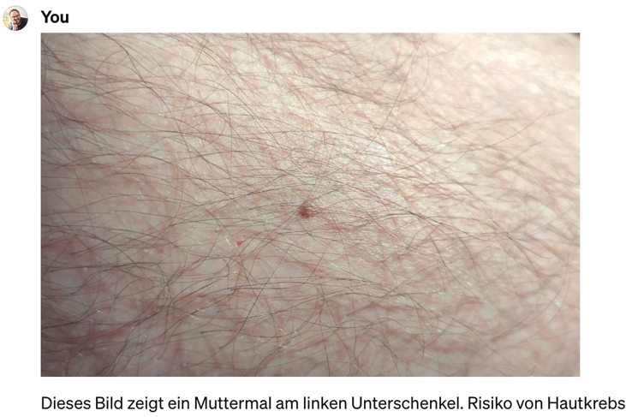
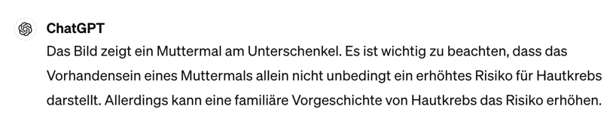
Bilder, Audio und Text.

Slide 18
Wie funktioniert Maschinelles Lernen?

Slide 19
1. element
2.
3.
4.
5.
6.
4, 5, 6, 7, 8, ?
“Datenpunkt”
Notes:
Let me start to explain what generalization is with the help of a game that many of you might have come across already. The game consists of extending a given sequence of objects, e.g., a sequence of numbers. In machine learning we often refer to these individual objects as data points.
Here we have a sequence of five numbers, 4, 5, 6, 7, 8 and the goal is to guess or predict the next element in the sequence. Generalization here means to be able to produce a good guess for the next element in the sequence.

Slide 20
“Merkmale”
1
1
1
“Label/Diagnose”
1/2
1
?
Notes:
Let us consider another instance of the sequence guessing game. In contrast to the previous game, here the sequence elements consist of two parts. The first part, which is known as the features of a data point, is a geometric figure. The second part of each sequence element is a number, the label of this element. Here, the goal is to guess the label of a new sequence element for which we are given the features.

Slide 21
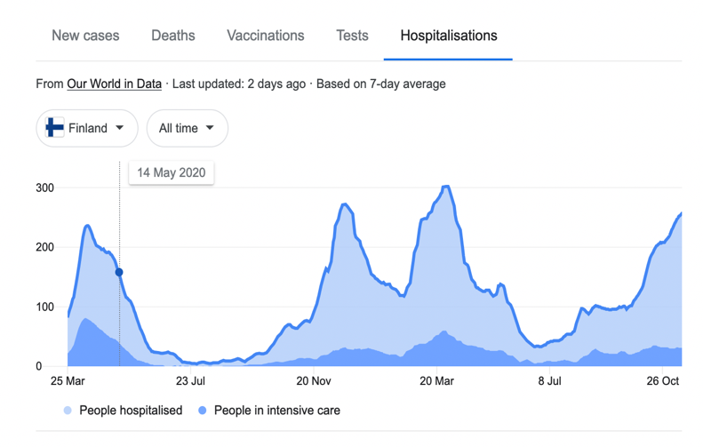
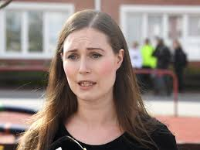
?
Notes:
A very timely example or application for the sequence guessing game is the forecasting of Covid-19 infections. Here, each sequence element represents some day during the current pandemic. We could use different epidemiological indicators as features for a particular day. The label of each day could be the number of confirmed Covid-19 infections we expect one week later. The goal is then to predict or guess the number of Covid-19 infections on week ahead in order to optimally plan health-care services.

Slide 22
ML Funktionsprinzip
Aus beobachteten Datenpunkten,
entwickle („lerne“) eine Hypothese
um Vorhersagen/Diagnosen zu machen.

Slide 23
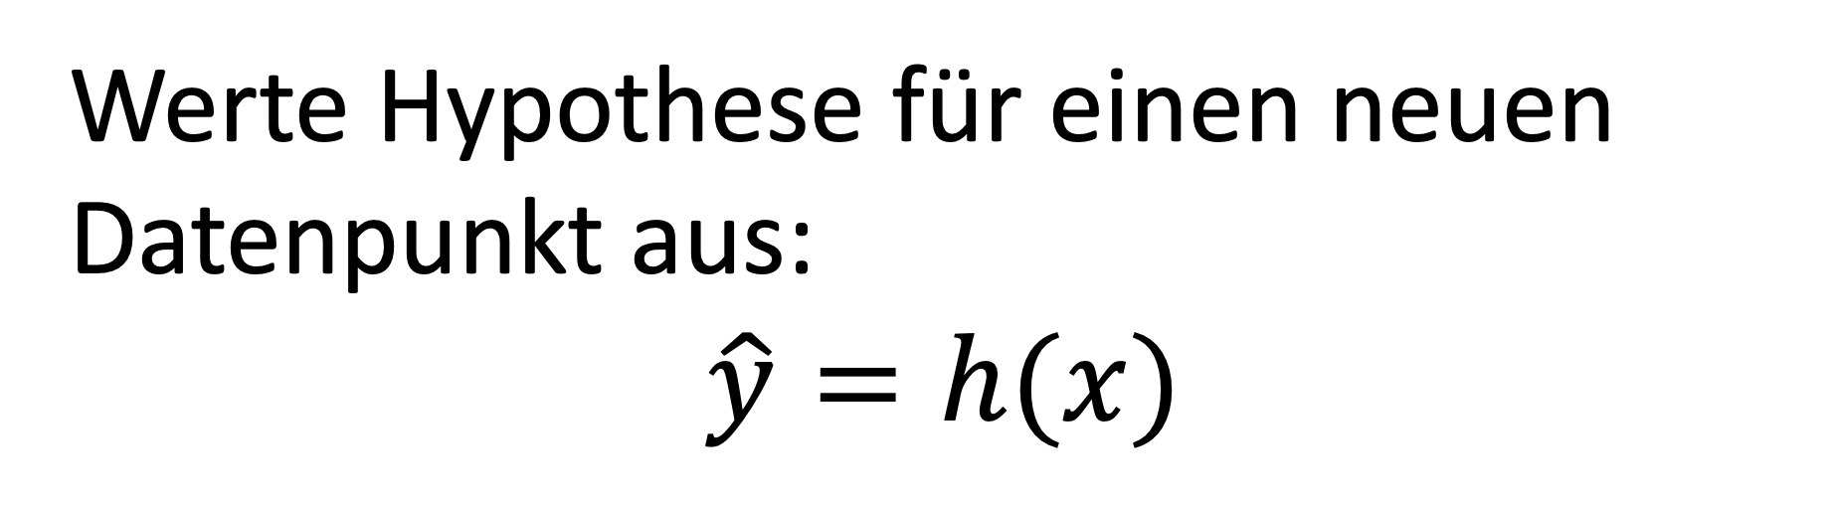
Wie Vorhersagen?
Werte Hypothese für einen neuen Datenpunkt aus:
$$\hat{y}=h(x)$$
Diagnose
Merkmale

Slide 24
Vorhersage
4, 5, 6, 7, 8, 9
gelernte Hypothese
Notes:
Consider again the sequence we have already shown before. This sequence starts with five numbers, 4, 5, 6, 7, 8. The question is then what could be a good guess for the next element in the sequence. Just by looking at the first five number, many of you might have formed immediately a hypothesis. This hypothesis might be that the sequence elements are linearly increasing according to a straight line. Using this hypothesis, we can predict the next element by continuing the straight line.

Slide 25
Was ist ein Datenpunkt?
Ein Objekt das Information trägt.

Slide 26
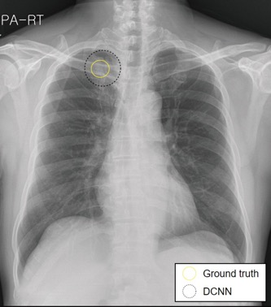
Datenpunkt = Röntgenaufnahme
Merkmale = Pixel Intensitäten
Diagnose = Gibt es bösartige Lungenknötchen?
https://pubs.rsna.org/doi/full/10.1148/radiol.2019182465

Slide 27
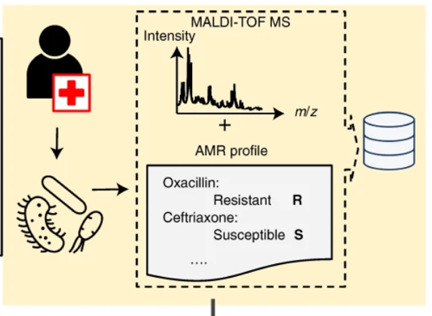
Datenpunkt=Pathogen
Merkmale = Massenspektrum
Diagnose = Resistenzen?
Weis, C., Cuénod, A., Rieck, B. et al. Direct antimicrobial resistance prediction from clinical MALDI-TOF mass spectra using machine learning. Nat Med 28, 164–174 (2022).

Slide 28
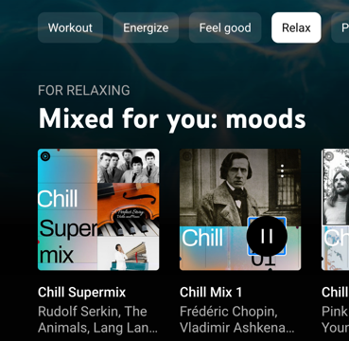
Datenpunkt=Stimmungstief
Merkmale = Google Verlauf
Diagnose = Welcher Komponist hilft?
Mallik A, Russo FA. The effects of music & auditory beat stimulation on anxiety: A randomized clinical trial. PLoS One. 2022 Mar 9;17(3):e0259312. doi: 10.1371/journal.pone.0259312. PMID: 35263341; PMCID: PMC8906590..

Slide 29
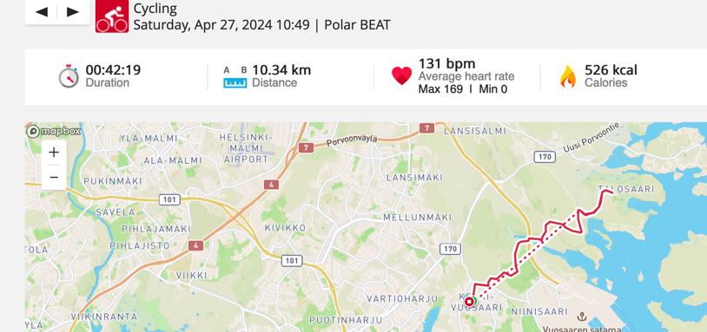
Datenpunkt = Aktivität
Merkmale = Pulsverlauf
Diagnose = Gesund?

Slide 30
Anatomie eines Datenpunkts
zwei Gruppen von Eigenschaften
Merkmale (engl. “Features”)
Diagnose (engl. “Label”)

Slide 31


Merkmale (als „x“ notiert)
Eigenschaften, die man “einfach” messen kann z.b. Körpergrösse, Gewicht, Blutdruck,
Gesundheitsakte,
Digitaler Fußabdruck

Slide 32
Diagnose (als „y“ notiert)
Eigenschaften, die man nicht “einfach” messen kann z.b. eine Erkrankung bzw. Risiko einer zukünftigen Erkrankung

Slide 33
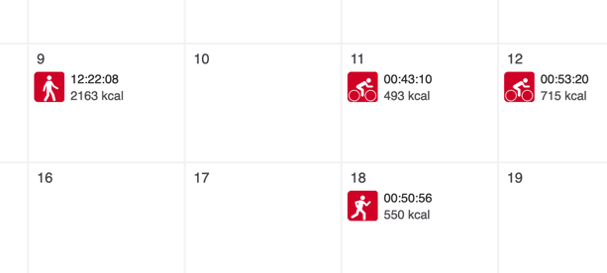
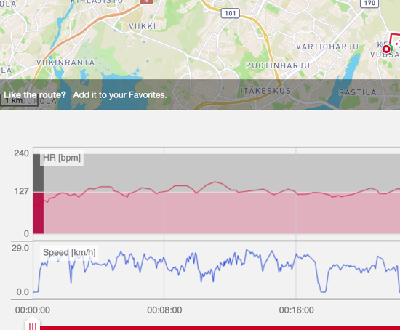
Merkmale einer Aktivität

Slide 34
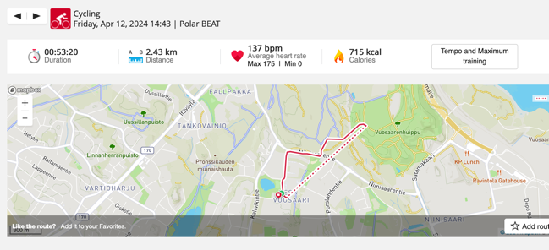
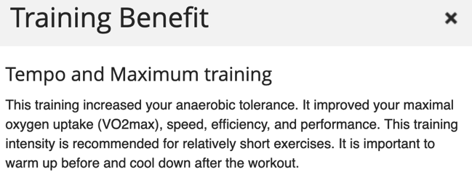
Diagnose einer Aktivität
Merkmal x
Diagnose y

Slide 35
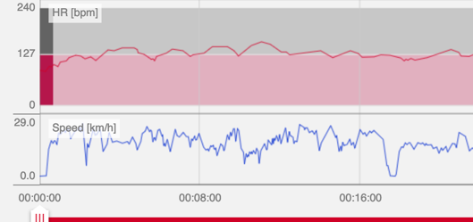
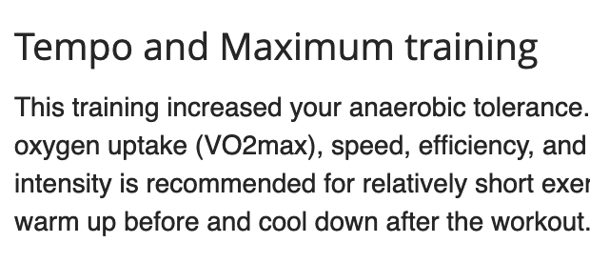
Hypothese ist Funktion h: x->y
h(.)
Merkmale x
Diagnose y

Slide 36
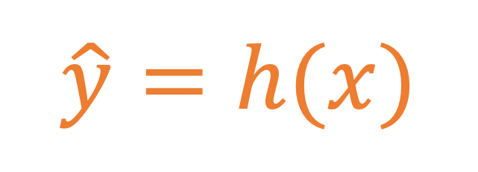
Eine Hypothese.
$$\hat{y}=h(x)$$
Label y
Merkmal x

Slide 37
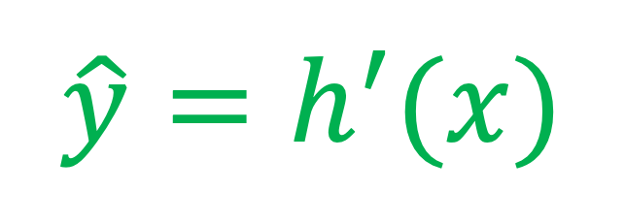
ML Model = Viele Hypothesen.
$$\hat{y}=h(x)$$
Diagnose y
$$\hat{y}=h^{′}(x)$$
Merkmale x

Slide 38
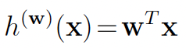
Lineares Model
Label y
Merkmal x

Slide 39
Nichtlin. Model (Deep Learning)
Label y
Merkmal x

Slide 40
Welche Hypothesis ist besser?
$$\hat{y}=h(x)$$
Label y
$$\hat{y}=h^{′}(x)$$
Merkmal x

Slide 41
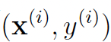
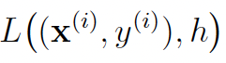
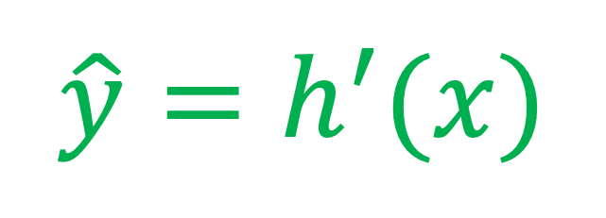

Verlust/Fehlerfunktion
Label y
$$\hat{y}=h(x)$$
Fehler
$$\hat{y}=h^{′}(x)$$
Merkmal x

Slide 42
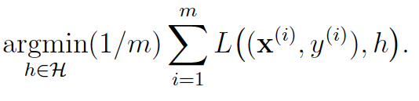
ML Funktionsprinzip
Lerne eine Hypothese (Trainiere ein Modell) um den Fehler y-h(x) zu minimieren.
Notes:
Machine learning methods learn a hypothesis for the intrinsic structure in observed data. Using this hypothesis, predictions about new elements or future events can be made.

Slide 43
Drei Komponenten des ML
Modell
Verlust/Fehlerfunktion
Jede Komponente bietet eine Wahlmöglichkeit.
Daten

Slide 44
KI Landschaft
Fehlerfunktion
deep RL
reinforcement
reward
cont. bandits
clustering err
subspace cl.
k-means
unsupervised
PoV
PCA
squared error
linear regression
supervised
decision tree
Chat GPT
cross-entropy
logistic regression
Model
linear
ANN

Slide 45
Entwicklungskriterien
Rechenaufwand
Zuverlässigkeit
Genauigkeit

Slide 46
Herausforderungen
KI braucht viele Datenpunkte für Training
Datenpunkte nicht frei zugänglich (Privatsphäre)!
Medizin KI benötigt hohe Zuverlässigkeit

Slide 47
Herausforderungen
KI braucht viele Datenpunkte für Training
Datenpunkte nicht frei zugänglich (Privatsphäre)!
Medizin KI benötigt hohe Zuverlässigkeit

Slide 48


KI braucht viele Datenpunkte
Label y
Merkmal x

Slide 49
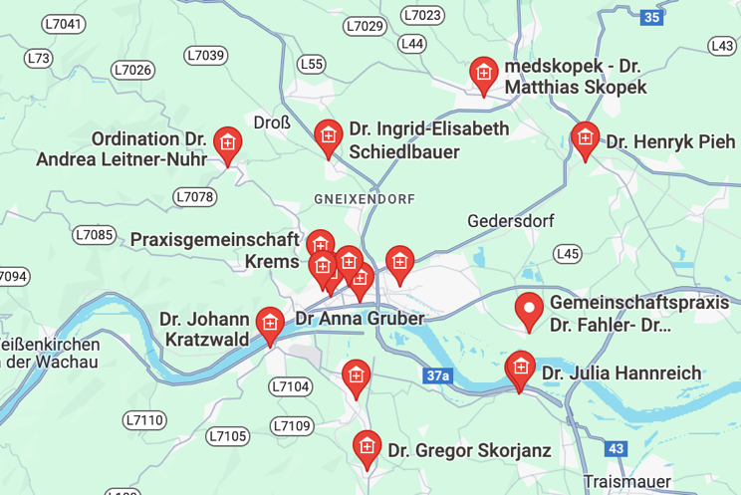
Dezentrale Gesundheitsdaten

Slide 50
Herausforderungen
KI braucht viele Datenpunkte für Training
Datenpunkte nicht frei zugänglich (Privatsphäre)!
Medizin KI benötigt hohe Zuverlässigkeit

Slide 51

Föderales Lernen

Slide 52






“…aims to revolutionize the way health data is managed and utilized across Europe."

Slide 53


„TEHDAS supports EU member states and the European Commission in building a European health data space by developing principles for the cross-border secondary use of health data.“

Slide 54
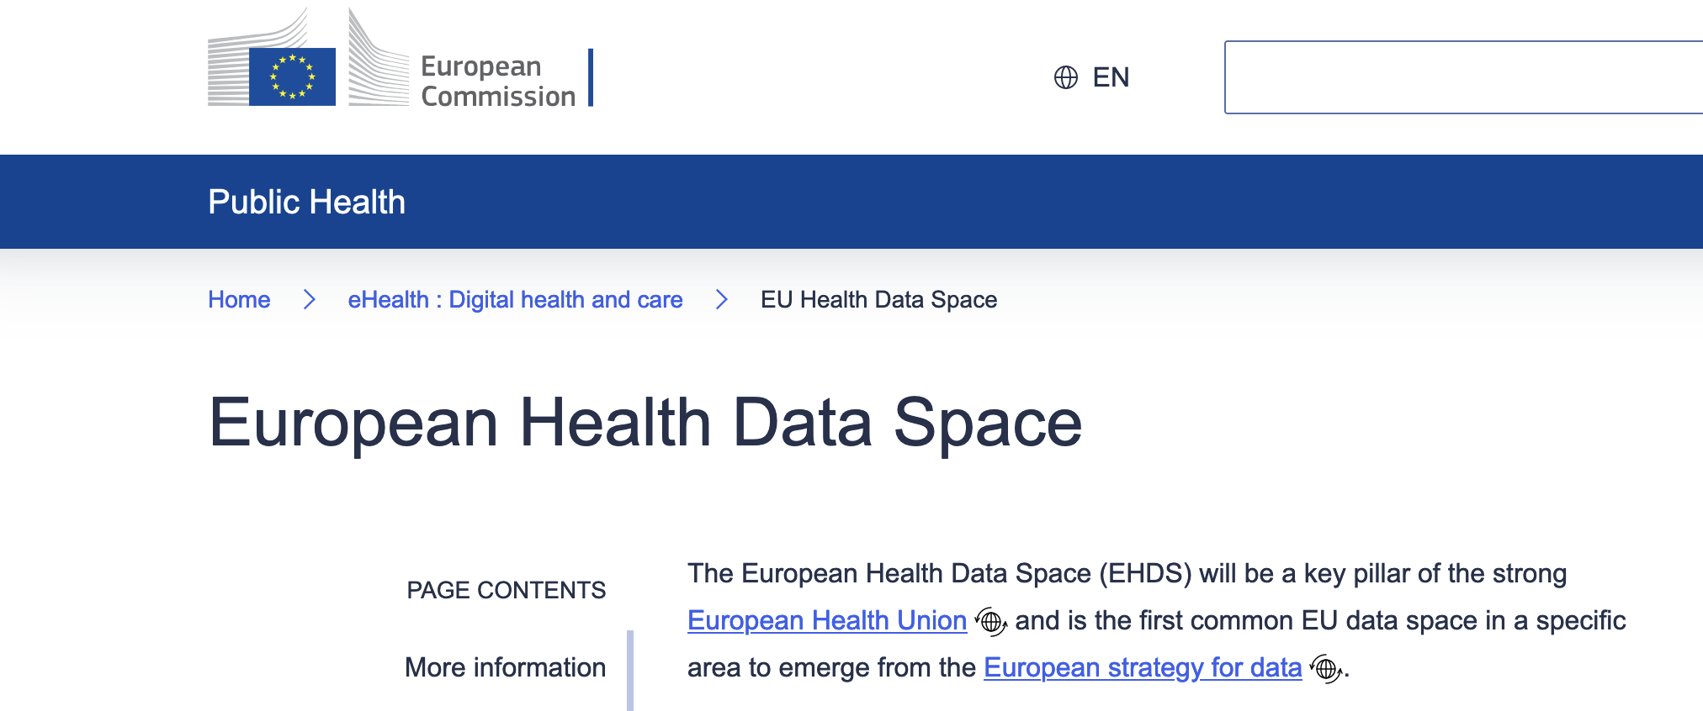

Slide 55
Herausforderungen
KI braucht viele Datenpunkte für Training
Datenpunkte nicht frei zugänglich (Privatsphäre)!
Medizin KI benötigt hohe Zuverlässigkeit

Slide 56
(Un-) Zuverlässigkeit von KI
Label y
Merkmal x

Slide 57
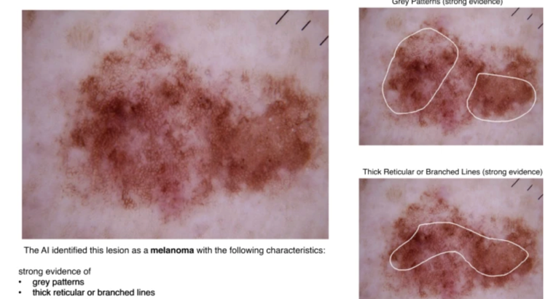
Zuverlässige KI ist erklärbar
Chanda, T., Hauser, K., Hobelsberger, S. et al. Dermatologist-like explainable AI enhances trust and confidence in diagnosing melanoma. Nat Commun 15, 524 (2024). https://doi.org/10.1038/s41467-023-43095-4

Slide 58
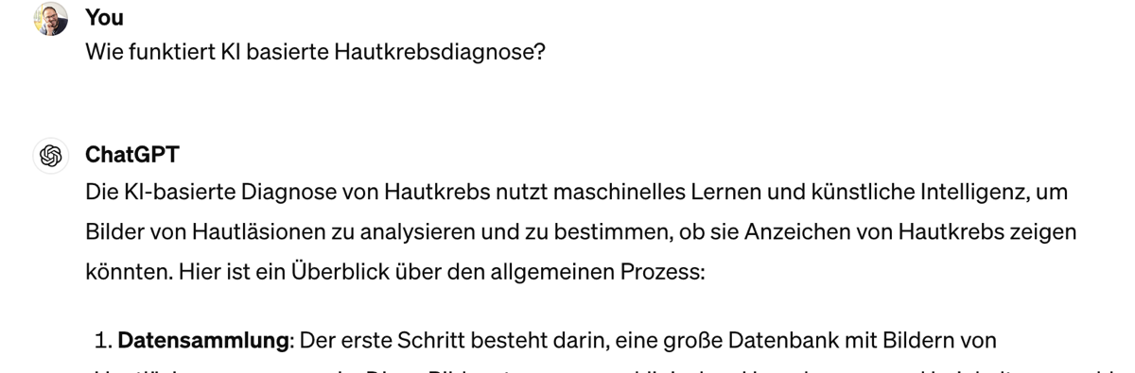
KI erklärt KI

Slide 59
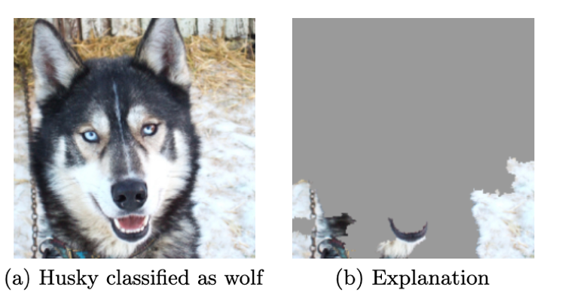
Wie gut ist eine Erklärung?
[1]Tulio Ribeiro, M., Singh, S., and Guestrin, C., “"Why Should I Trust You?": Explaining the Predictions of Any Classifier”, <i>arXiv e-prints</i>, 2016. doi:10.48550/arXiv.1602.04938.

Slide 60
Was sind die drei Komponenten von KI?

Slide 61
Fragen ?

Slide 62

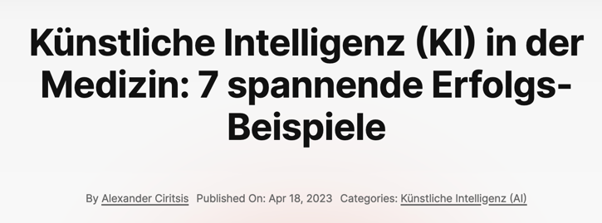
Lektüre

